Slide 1
PowerPoint Presentation on

Slide 2
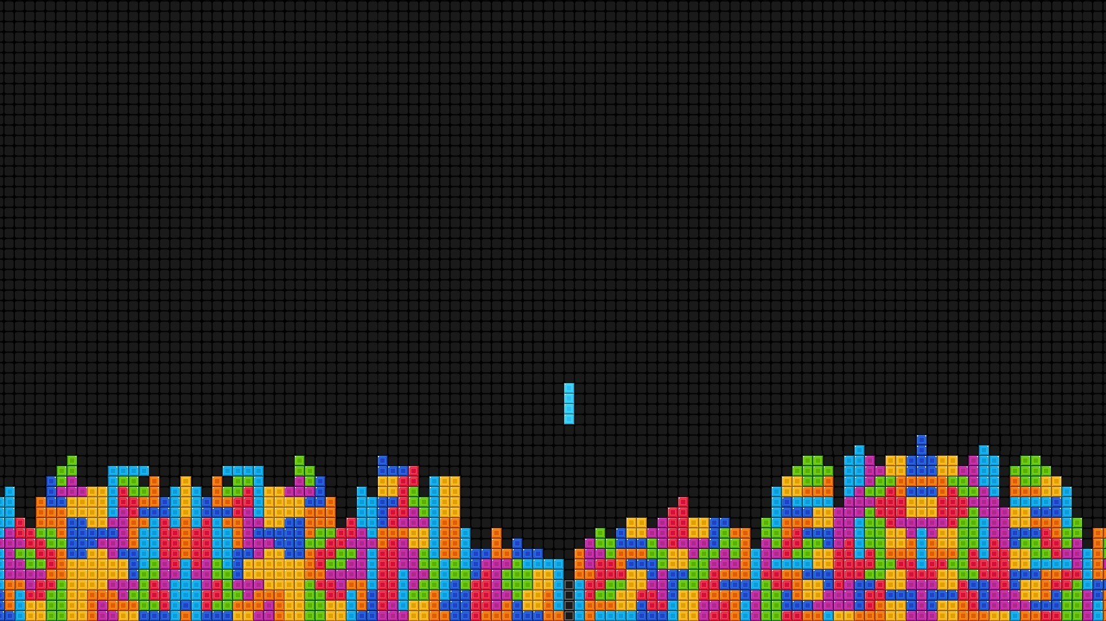
TETRIS

Slide 3
About The Game
It is a tile matching puzzle game
Blocks drops from the top and lands at the bottom.
Landing of a block triggers the downward movement of another block.

Slide 4
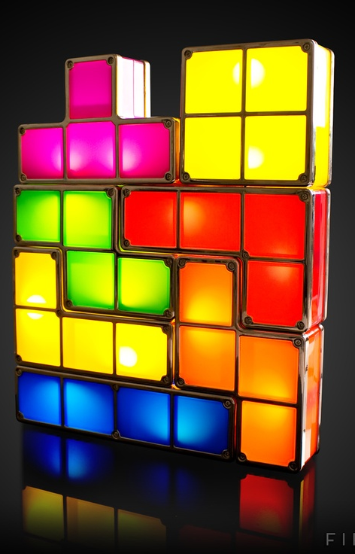
TETROMINOES
Tetrominoes are geometric shapes composed of four squares blocks each in seven different shapes which can be rotated by 90⁰

Slide 5
I-Block
Z-Block
T-block
O-Block
L-Block
S-Block
J-Block

Slide 6
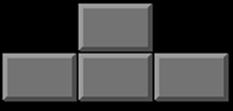
How to play
Click on Right arrow key to move block Right
Click on Spcebar to rotate block by 90º
Click on Left arrow key to move block left
Click on Down arrow key to move block Downward fast

Slide 7
Objective and scoring
The main objective of the game is eliminating blocks by completing a horizontal line of blocks to earn points.

Slide 8
Whenever a line completes score add up as follows :-

Slide 9
Made by Mintoo Kumar 303/COE/13 Nitesh Dodeja 312/COE/13 Piyush Singhal 319/COE/13

Slide 10


